Slide 1
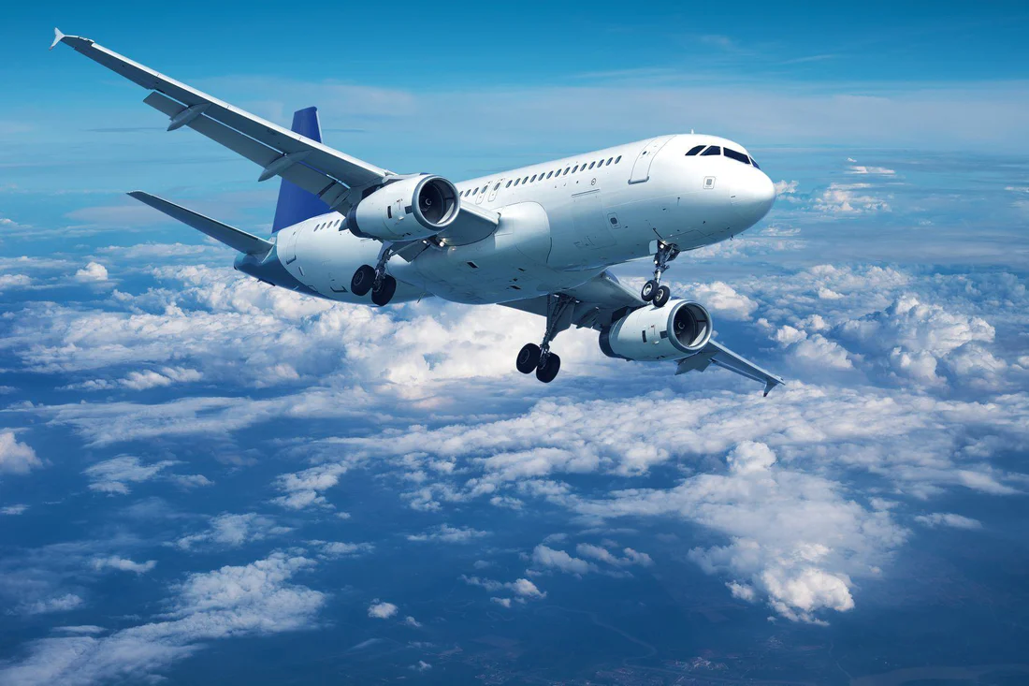
Aviation Project : Flight Delay Analysis

Slide 2
Index 1
Overview ...…………………………….………………………….………………………….……………………….………………………….………………..... 5
KPI’s of the Project ……………………….………………………….………………………………………….………………………….…………………… 6
Weekend vs Weekday Flight Statistics ……………………….………………………….…………………………….…………………………....... 7
Total number of cancelled flights for JetBlue Airways on first date of every month ………….………………………….……. 8
Week Wise Delay Statistics of flights ………….………………………….…………………………….………………………….…………………... 9
City Wise Delay Statistics of flights ………….………………………….…………………………….………………………….……………………… 10
State Wise Delay Statistics of flights ………….………………………….…………………………….………………………….……………………. 11
Airline wise Delay Statistics of flights ………….………………………….…………………………….………………………….………………….. 12
Number of airlines with No departure/arrival delay with distance covered between 2500 and 3000 …………………. 13
Flight Delay Analysis Dashboard 1 - Power BI ………….………………….………………………………………….……………….………….. 14
Flight Delay Analysis Dashboard 2 - Power BI ………….………………….………………………………………….……………….………….. 15
Flight Delay Analysis Dashboard-Tableau page1 ……………………………………………….………………….……………….………........ 16

Slide 3
Index 2
Flight Delay Analysis Dashboard-Tableau page 2 ……………………………………………….………………….……………….………...... 17
Flight Delay Analysis Dashboard-MS Excel ………..……………………………………………….………………….……………….………...... 18
SQL – KPI 1 & 2 ……………………….………………………….………….………….…………………………….…………………………...................... 19
SQL – KPI 3 ……………………….………………………….………….………….…………………………….…………………………............................... 20
SQL – KPI 4 ……………………….………………………….………….………….…………………………….…………………………............................... 21
Challenges ………….………………………….…………………………….……………………………………………….……………………………………… 22
End ………….………….………………………….…………………………….…………………………….……………….………………….……………………. 23

Slide 4
Overview
The Aviation Analysis project focuses on examining flight delay analysis. It delves into various key performance indicators (KPIs), including Weekday Vs Weekend total flights statistics, Total number of cancelled flights for JetBlue Airways on first date of every month, Week wise, State wise and City wise statistics of delay of flights with airline details, and Number of airlines with No departure/arrival delay with distance covered between 2500 and 3000. The analysis entails processing three CSV files, meticulously cleansed and transformed to meaningful insights.

Slide 5
KPI’S of the Project
KPI 1 : Weekday Vs Weekend total flights statistics
KPI 2 : Total number of cancelled flights for JetBlue Airways on first date of every month
KPI 3 : Week wise, State wise and City wise statistics of delay of flights with airline details
KPI 4 : Number of airlines with No departure/arrival delay with distance covered between 2500 and 3000

Slide 6
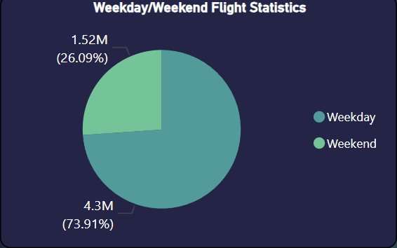
Weekend vs Weekday Flight Statistics
KPI 1
Observations/Analysis:
The Data depicts that the weekday flights comprises of around 4.3 million which is around 73.91% of total flights while weekend flights count comprises of 1.52 million which is around 26.09 % of the total flights in a year.
Conclusions/Suggestions:
In order to increase the weekend flights and balance the flight distribution implementing special promotions, discounts, and enhanced loyalty program benefits can encourage and increase passenger traffic on weekend flights.

Slide 7
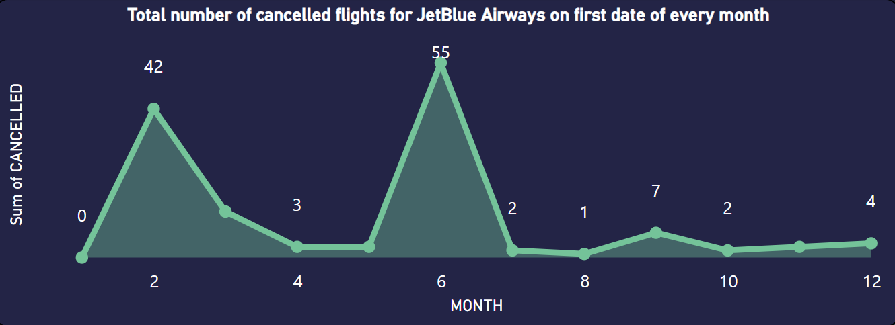
Total number of cancelled flights for JetBlue Airways on first date of every month
KPI 2
Observations/Analysis:
The data indicates that the 2nd and 6th months have the highest number of cancelled flights, with 42 and 55 cancellations respectively, while other months each have fewer than 10 cancellations.
Conclusions/Suggestions:
To reduce cancellations in the 2nd and 6th months, JetBlue Airways must analyze root causes, enhance maintenance and crew scheduling, invest in advanced forecasting technologies, streamline operations, and improve customer communication and contingency planning.

Slide 8
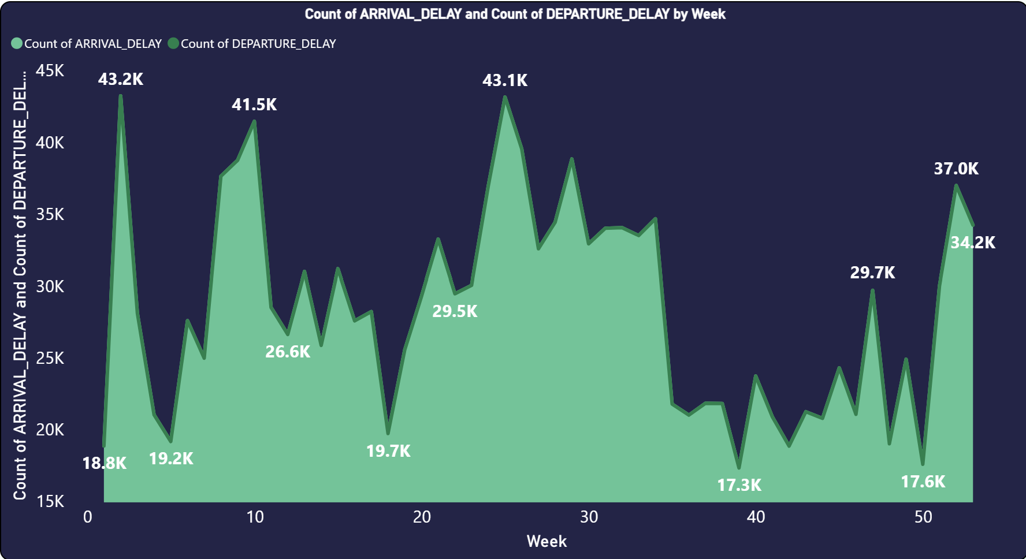
Week wise Delay Statistics of flights
KPI 3 A
Observations/Analysis :
The Count of Arrival and Departure delay for the first week is around 19K which further raised to 43K in week 2 which is the highest during the year in the 39th week recorded the lowest number of Arrival and Departure delay and the year ended with 34K delays in the last week
Conclusion/Suggestions :
To reduce delays, focus on weeks with the highest and lowest counts, analyze the reasons, optimize scheduling and maintenance, leverage predictive technologies, and enhance operational efficiency and communication.

Slide 9
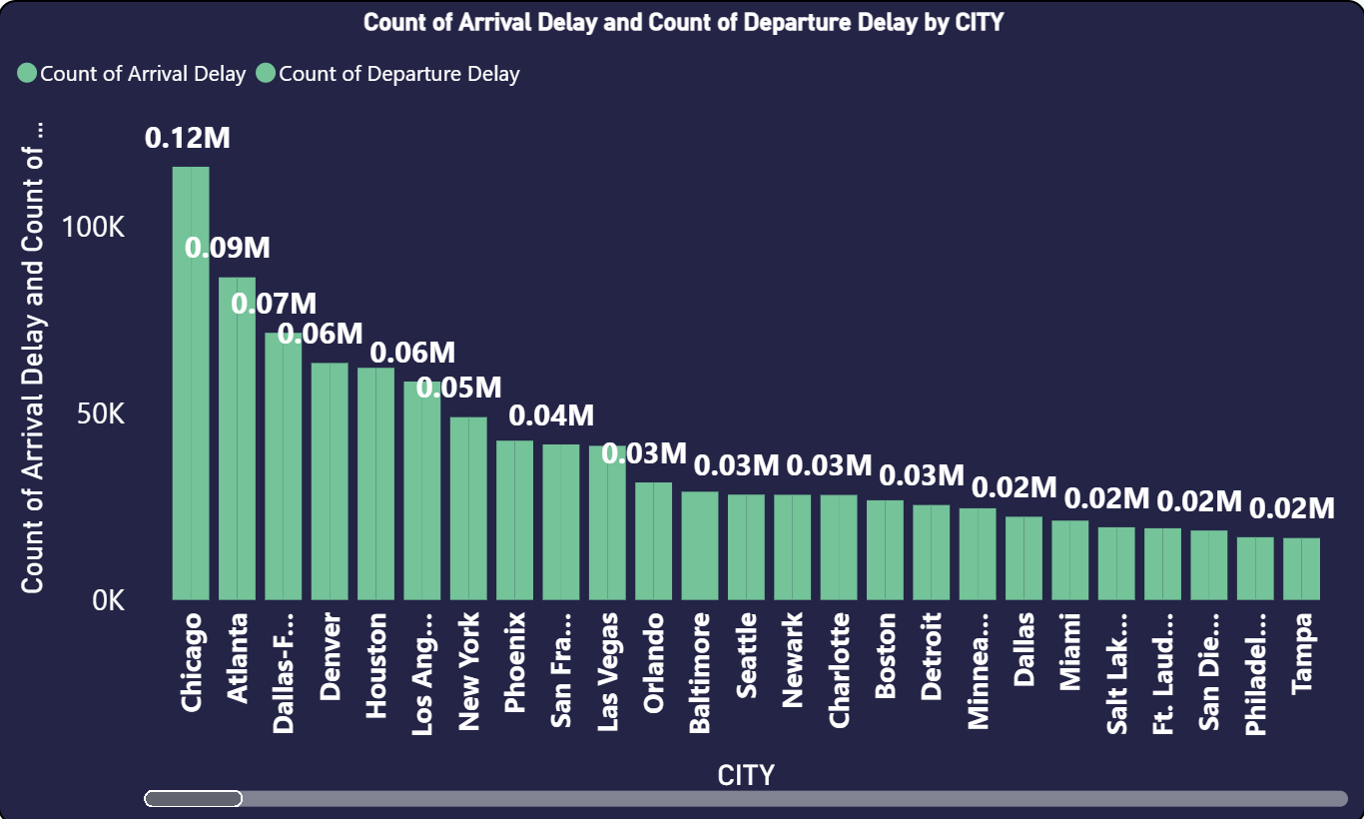
City Wise Delay Statistics of flights
KPI 3 B
Observations/Analysis :
According to the data Chicago city has the highest count of arrival and departure delay i.e. around 0.12 million followed by Atlanta with 0.09 million, New York has a count of delay around 0.05 million and the least number of delays are from the city Moab with a count of 7 delays.
Conclusion/Suggestions :
To decrease delays, expand runways and improve ground handling, deploy real-time weather monitoring systems, implement dynamic slot allocation, and maintain efficient scheduling where delays are minimal.

Slide 10
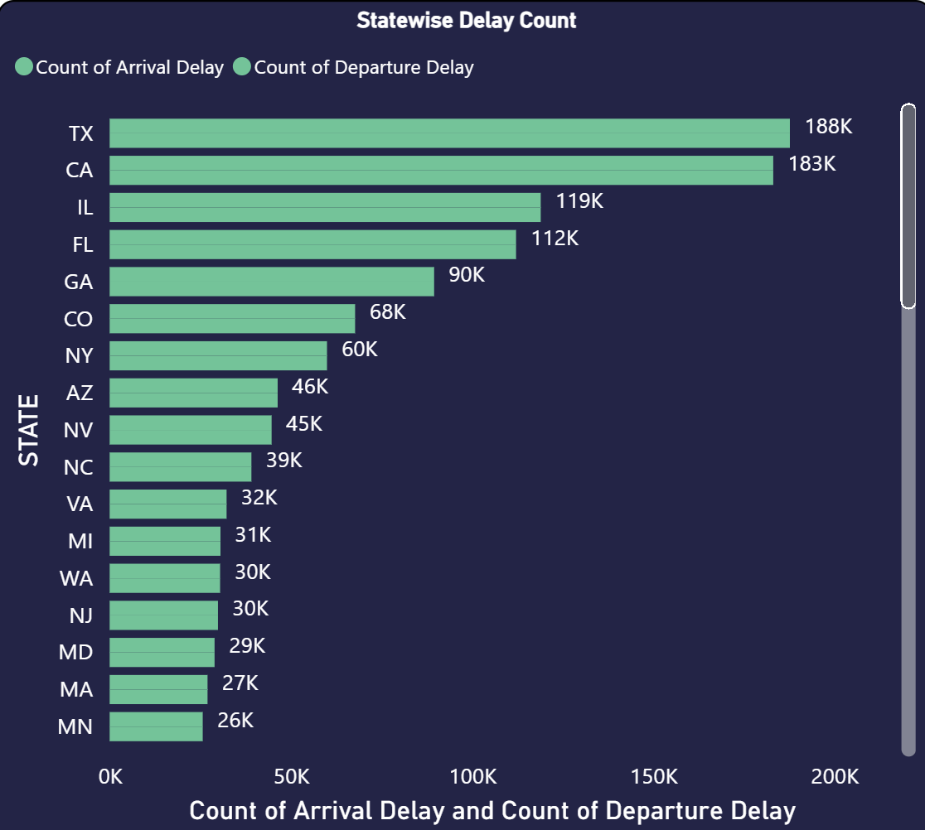
State Wise Delay Statistics of flights
KPI 3 C
Observations/Analysis :
In terms of delay with respect to the state Texas has the highest amount of delays i.e. 188 K followed by California with 183 K delays, Illinois and Florida have a delay of 119 K and 112 K respectively while American Samoa has the lowest delays with a count of 42 delays.
Conclusion/Suggestions :
To reduce delays, enhance air traffic management, optimize runways, modernize airport infrastructure, and improve public transport connections. Expand capacities, use real-time management, and develop effective hurricane and weather response plans thus helping in managing weather-related and regional disruptions. Optimize flight scheduling and invest in local facilities.

Slide 11
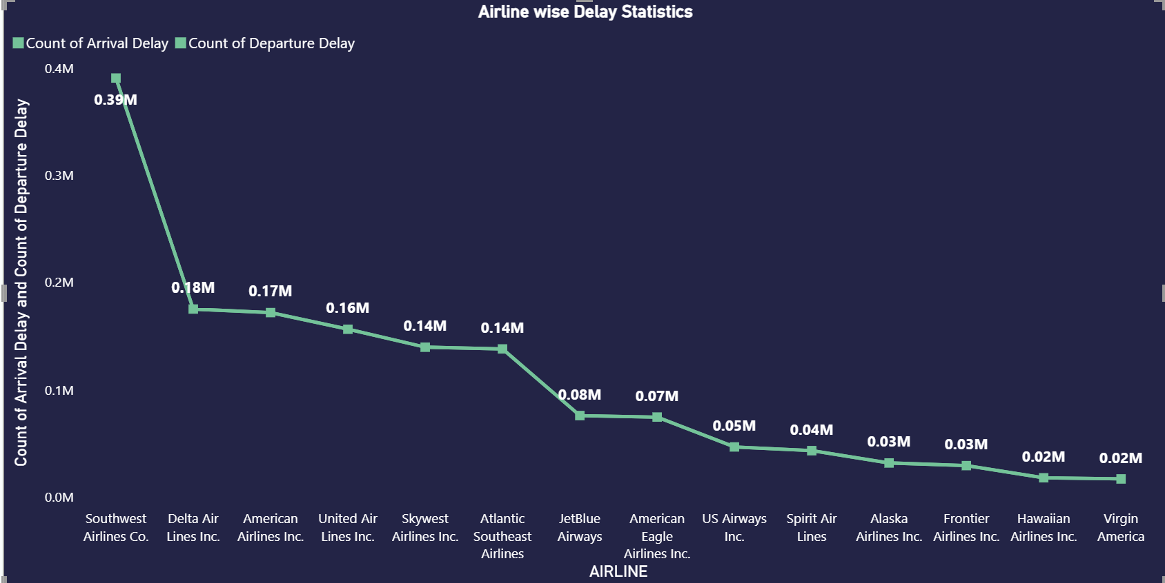
Airline wise Delay Statistics of flights
Observations/Analysis:
In terms of airline wise delay the data depicts that Southwest Airlines Co has the highest number of delay i.e. 0.39 millions followed by Delta Airlines which has around 0.18 millions and American Airlines which has a delay count of 0.16 million, while Virgin America has the least number of delays i.e. of around 0.02 million.
Conclusion/Suggestions:
Southwest Airlines and others above the 0.10 million count of delay should identify the root cause of delays and analyse the practices followed by other airlines to reduce the number of delays. These companies should also focus on implementing an optimized flight scheduling system to minimize delays
KPI 3 D

Slide 12
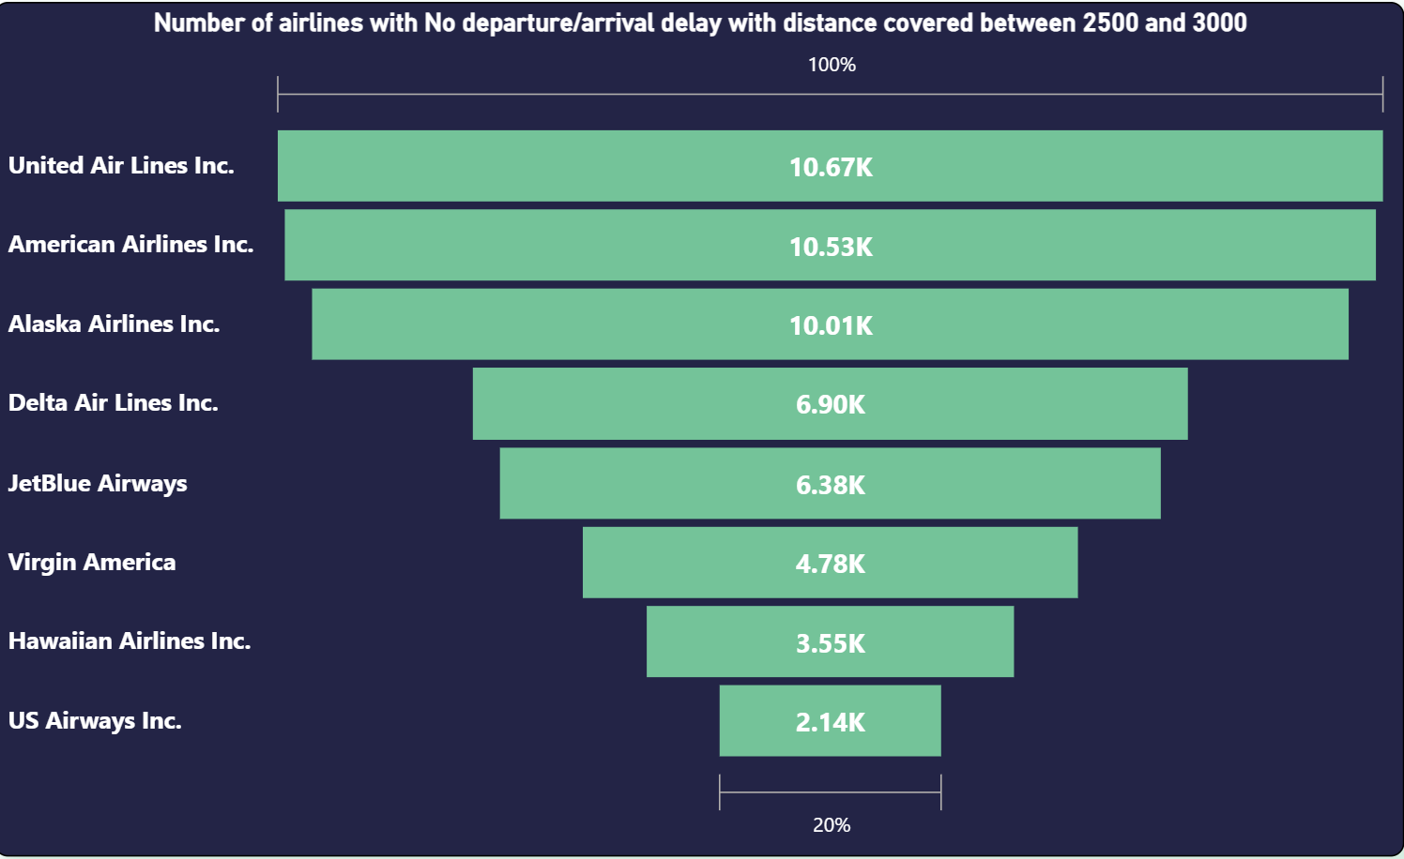
Number of airlines with No departure/arrival delay with distance covered between 2500 and 3000
KPI 4
Observations/Analysis:
The data depicts that United Airlines inc is the most successful airline with the highest number of No Departure/No Arrival Delay i.e. 10.67 K for distance between 2500 to 3000 km while American Airlines ranks 2nd with around 10.53 K flights in the No Arrival and No Departure delay Category, while US Airways Inc ranks last with a number of 2.14 K No Arrival and No Departure delay category.
Conclusion/Suggestions:
To improve figures in the No Departure/No Arrival Delay category, US Airways Inc. should focus on enhancing operational efficiency by adopting advanced scheduling systems, improving maintenance practices, and optimizing flight routes. Additionally, investing in staff training and upgrading technology for better real-time tracking and communication can help reduce delays and improve overall performance.

Slide 13
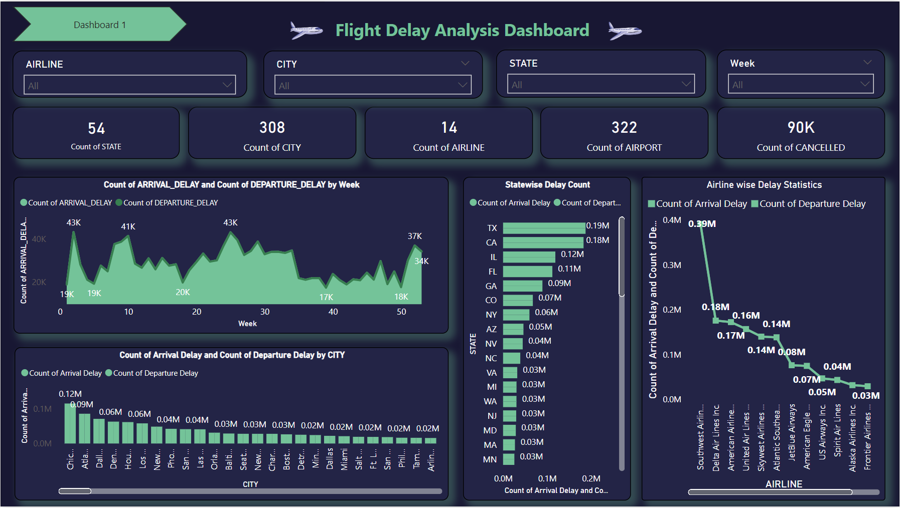

Slide 14
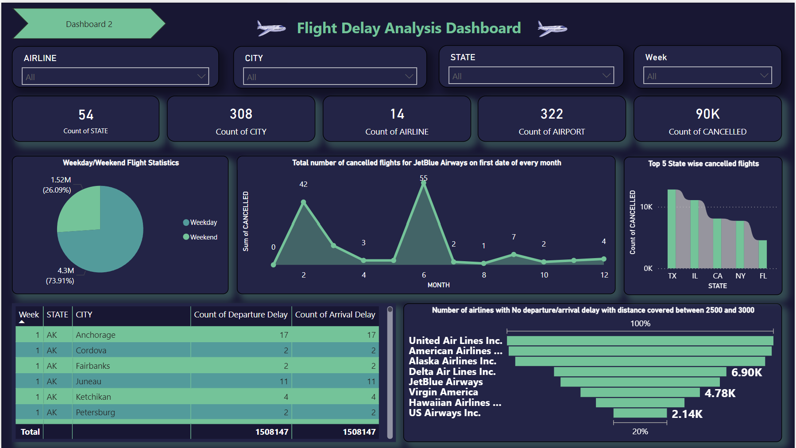

Slide 15
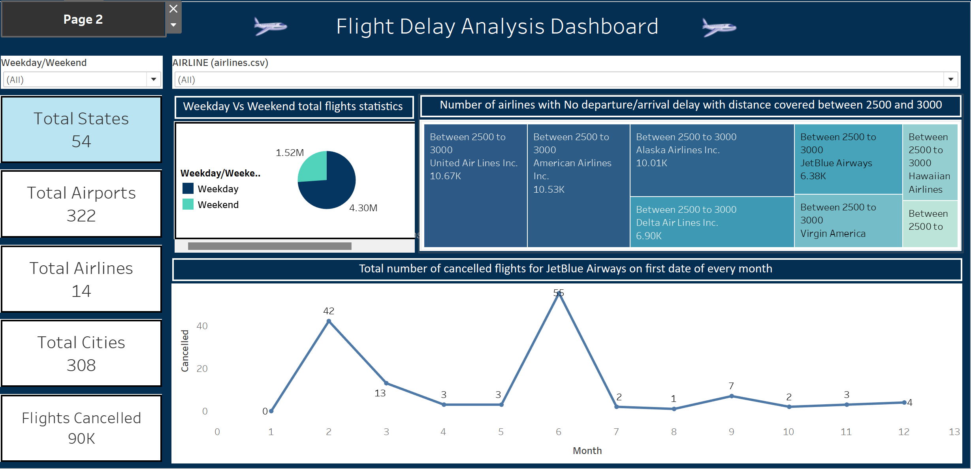

Slide 16
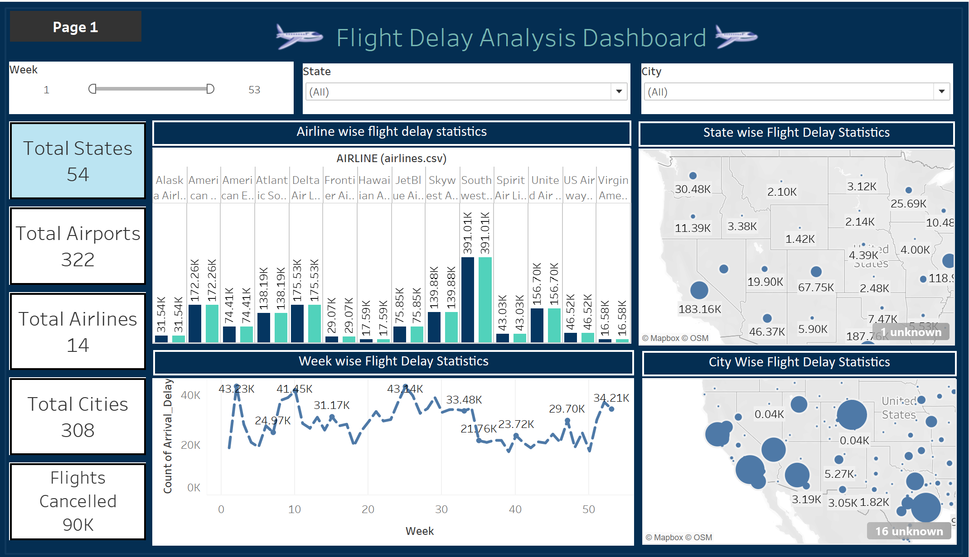

Slide 17
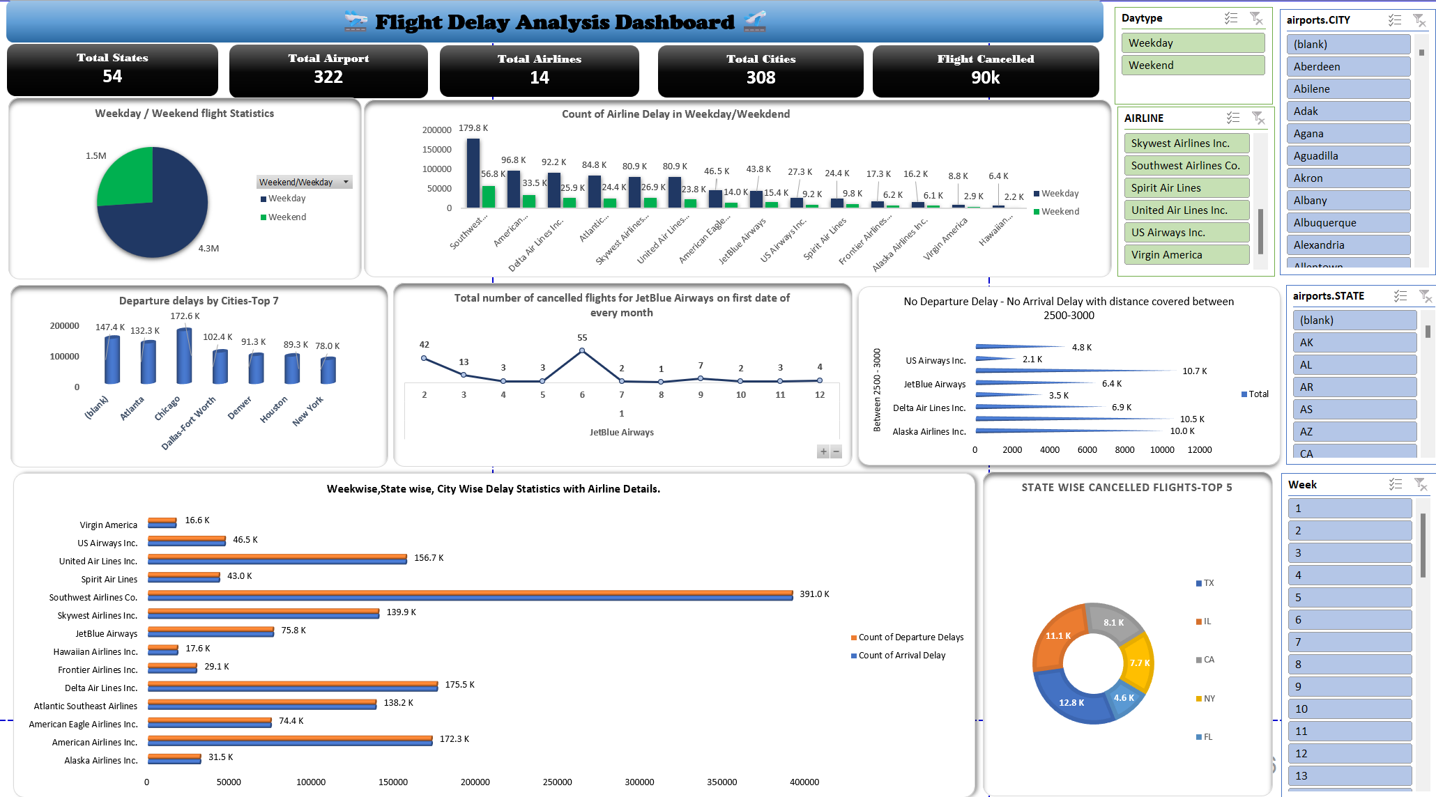

Slide 18
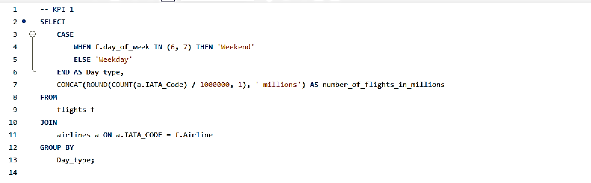
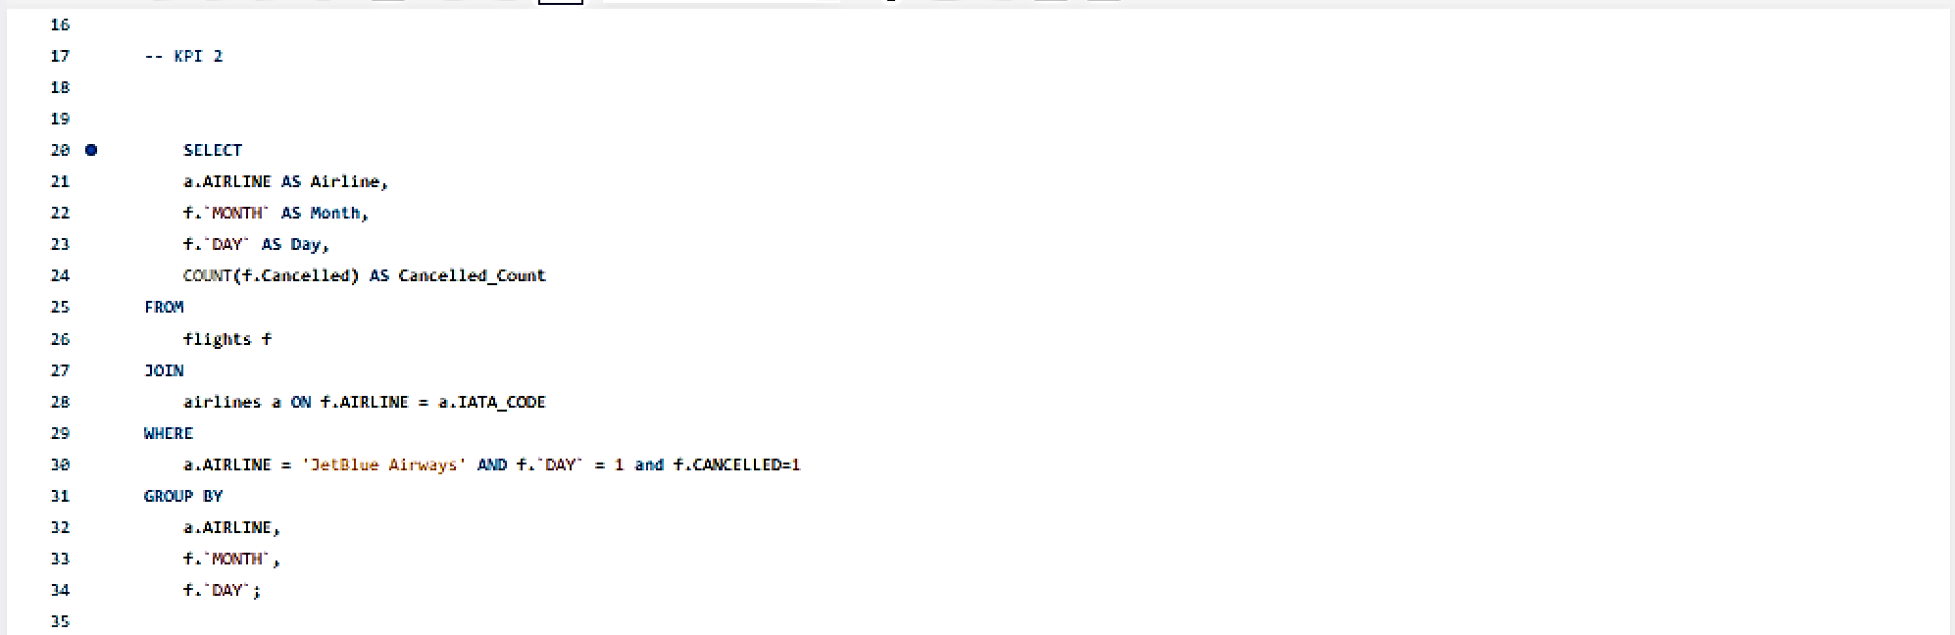

Slide 19



Slide 20
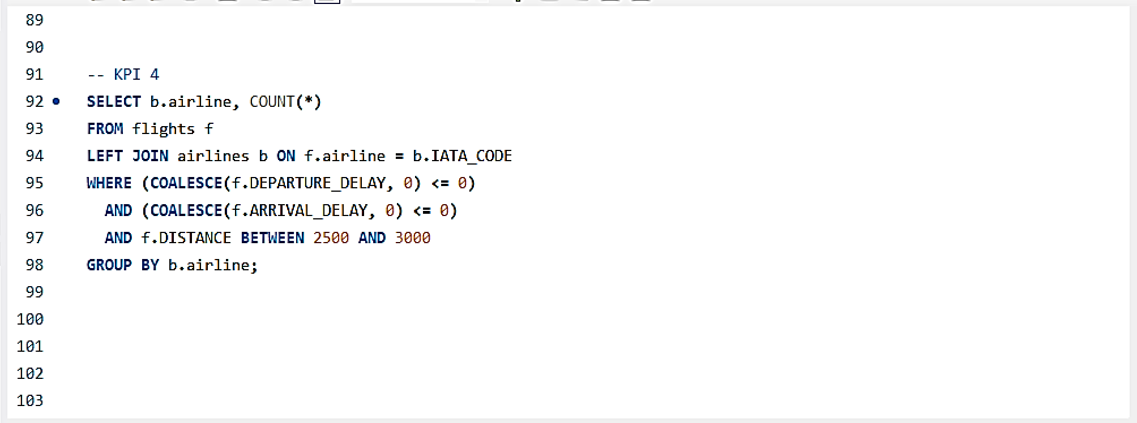

Slide 21
Thank you !!

